Slide 1


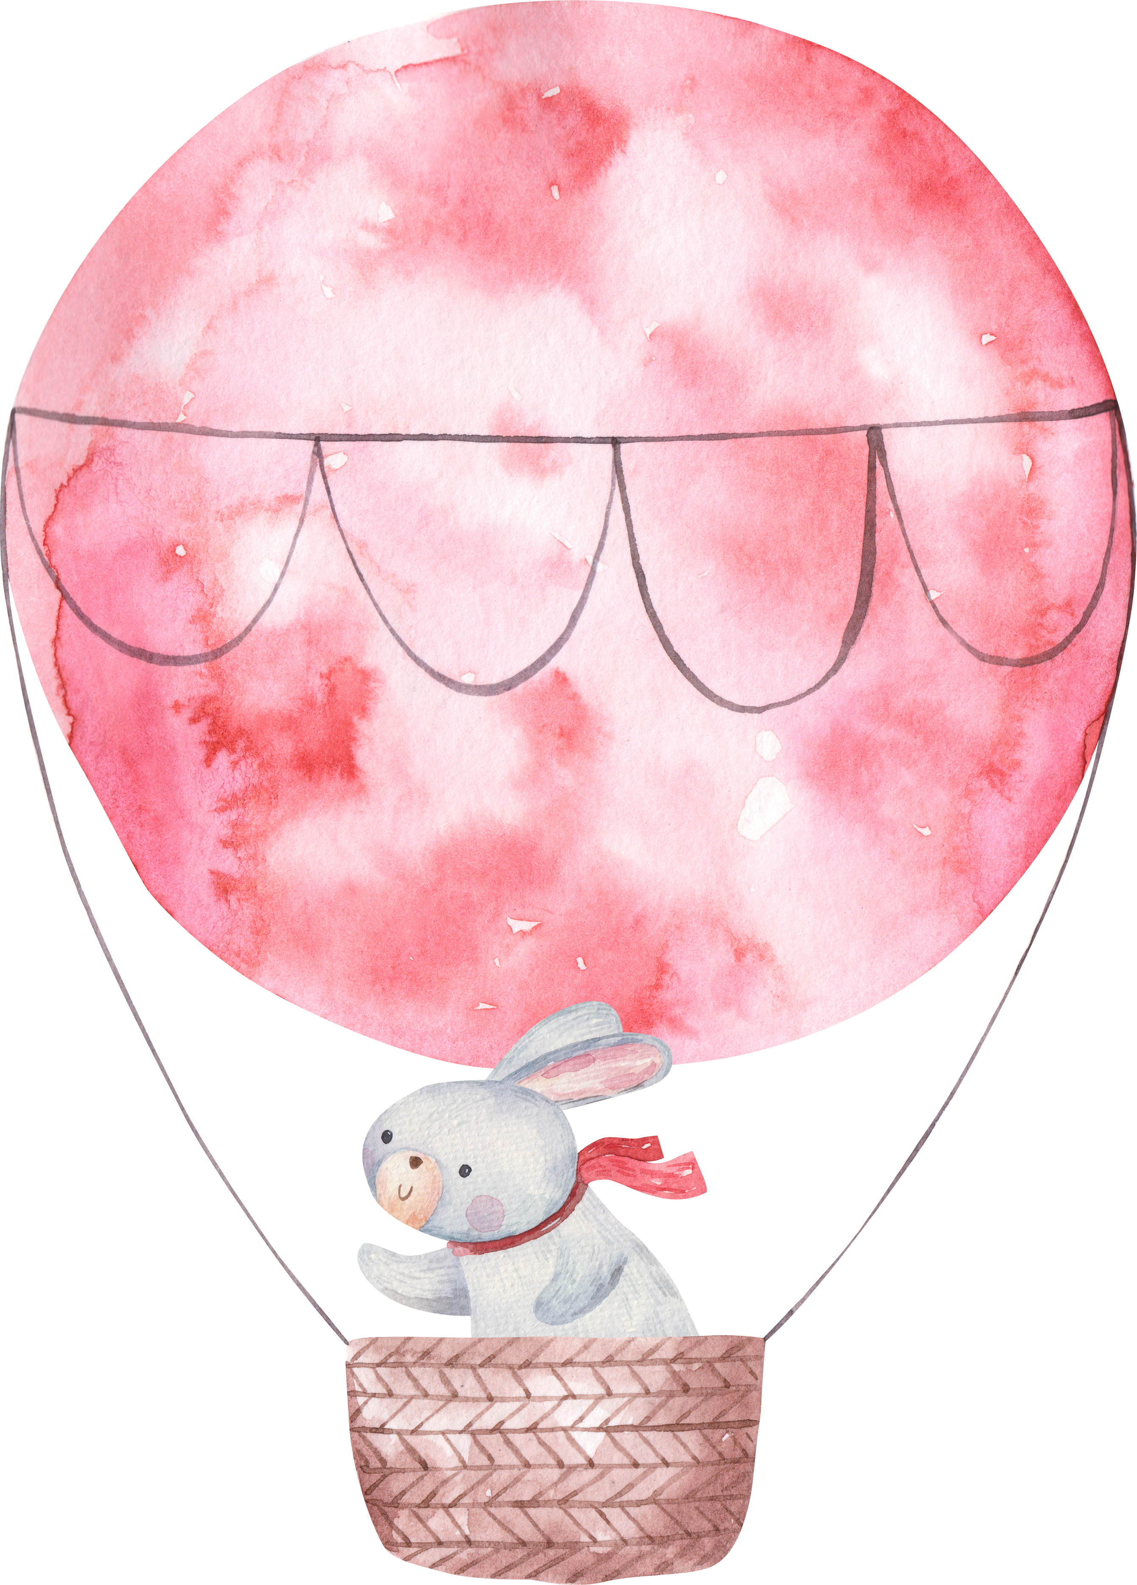
Oh Baby!
OLIVIA’S
BABY
SHOWER
June 19, 2030

